Slide 1
Maintenance
IEEE defines maintenance as a process of modifying a software system or component after delivery to correct faults, to improve performance or other attributes or to adapt the product to a changed environment.
The objective is to ensure that the software is able to accommodate changes after the system has been delivered and deployed.
Software maintenance is a part of software development life cycle. Its main purpose is to modify and update software application after delivery to correct faults and to improve performance.
Software is a model of the real world. When the real world changes, the software requires alteration wherever possible.

Slide 2
Contd..
Software maintenance is a vast activity which includes optimization, error correction, deletion of discarded features and enhancement of existing features.
Since these changes are necessary, a mechanism must be created for estimation, controlling and making modifications.
The essential part of software maintenance requires preparation of an accurate plan during the development cycle.
Typically, maintenance takes up about 40-80% of the project cost, usually closer to the higher pole. Hence, a focus on maintenance definitely helps keep costs down

Slide 3
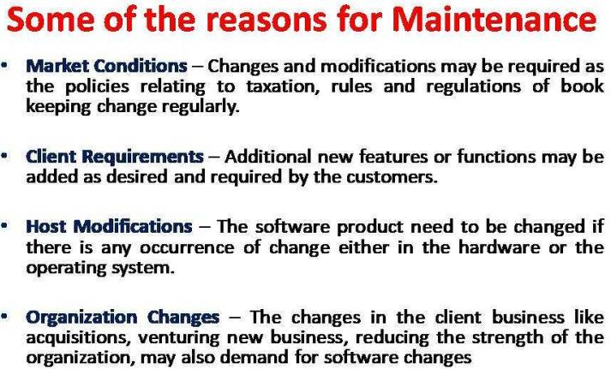

Slide 4
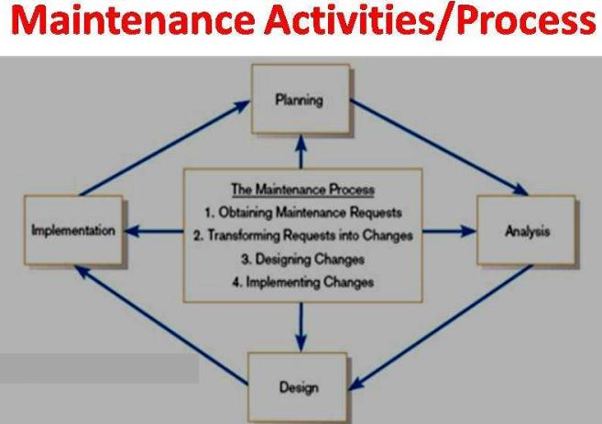

Slide 5
Types Of Maintenance
Corrective Maintenance
In the presence of any problems, these problems are corrected by taking up the corrective maintenance.
These problems may be either discovered by the user or the reports generated by the user
Adaptive Maintenance
For keeping the product up-dated with respect to the technological changes, organizational business rules and policies, the software is modified and updated by using adaptive maintenance

Slide 6
Perfective Maintenance
Perfective changes refers to the evolution of requirements and features in our existing system.
As our software gets exposed to users they will think of different ways to expand the system or suggest new features that they would like to see as part of the software, which in turn can become future enhancements to the system.
Perfective changes also includes removing features from a system that are not effective and functional to the end goal of the system.
Preventive Maintenance
The probable future problems of the software are prevented by regularly updating and modifying the software which is known as preventive maintenance.
The issues that are likely to cause big problems in the future are being addressed by preventive maintenance.

Slide 7
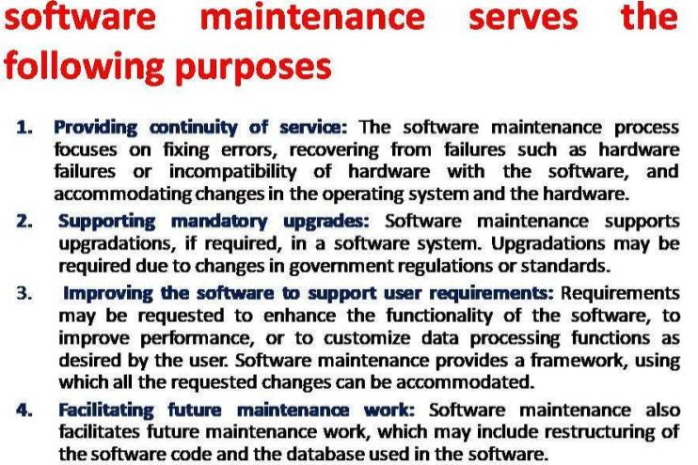

Slide 8
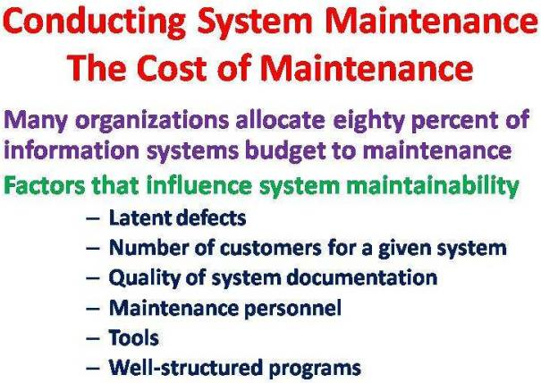

Slide 9
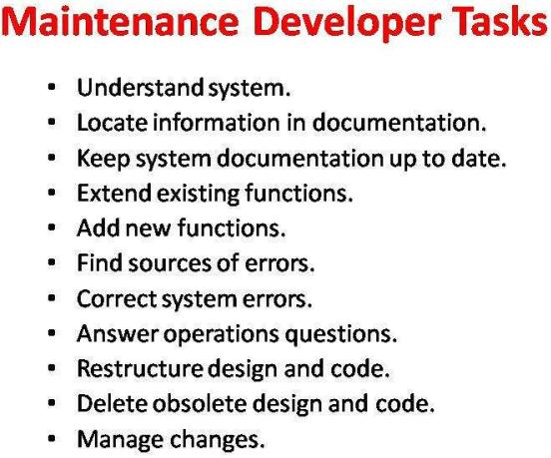

Slide 10
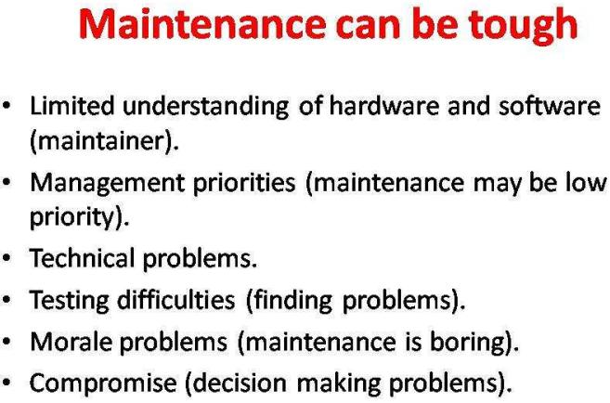

Slide 11
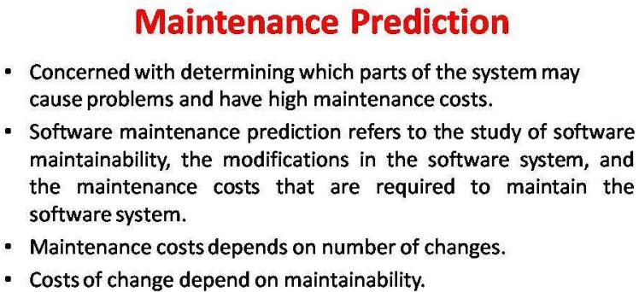

Slide 12
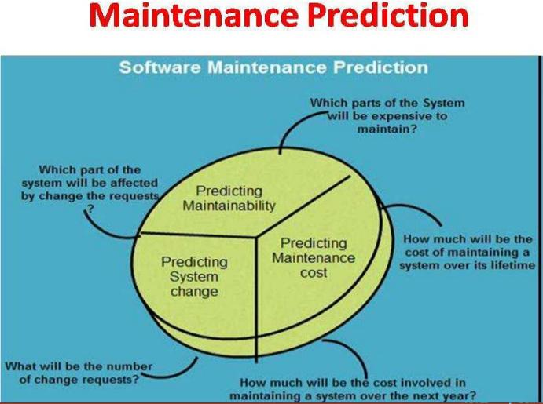

Slide 13
Software Reengineering
Software Reengineering is the process of updating software without affecting its functionality.
This process may be done by developing additional features on the software and adding functionalities that may or may not be required but considered to make the software experience better and more efficient.
Thus, software reengineering is a step towards continuous improvement of software for it to be handled better by developers and clients alike.
Additionally, it is a way to make existing products continue in service.

Slide 14
Contd…
Reengineering allows you to discover unnecessary steps and resources that have been implemented in our current software and remove them from the implemention, therefore minimizing the costs(time, financial, direct, indirect etc) that could be incurred. If a client needs a product you already have but requires added features, we may only have to re-engineer the existing one to save costs.
Software Re-engineering is the examination and alteration of a system to reconstitute it in a new form. In Software Re-engineering, we are improving the software to make it more efficient and effective.

Slide 15
Reengineering
Restructuring or rewriting part or all of a system without changing its functionality.
Applicable when some (but not all) subsystems of a larger system require frequent maintenance
Reengineering involves putting in the effort to make it easier to maintain.
The reengineered system may also be restructured and should be re-documented

Slide 16
Re-Engineering cost factors:
The quality of the software to be re-engineered.
The tool support availability for engineering.
Extend of the data conversion which is required.
The availability of expert staff for Re-engineering

Slide 17
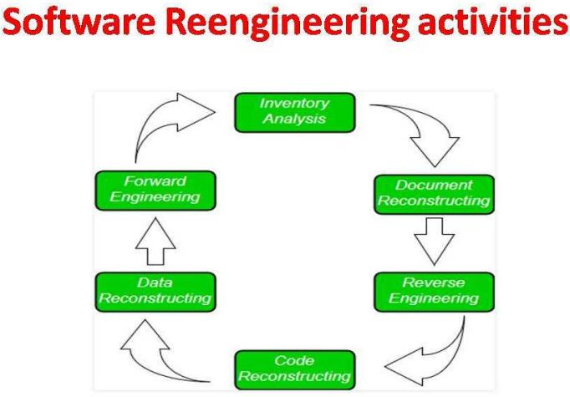

Slide 18
1. Inventory Analysis:
Every software organization should have an inventory of all the applications.
Inventory can be nothing more than a spreadsheet model containing information that provides a detailed description of every active application.
By sorting this information according to business criticality, longevity, current maintainability and other location important criteria, candidates for re-engineering appear.
Resource can then be allocated to candidate application for re-engineering work.
2. Document reconstructing:
Documentation of a system either explains how it operate or how to use it.
Documentation must be updated
The system is business critical and must be fully re-documented.

Slide 19
3. Reverse Engineering:
Reverse engineering is a process of design recovery. Reverse engineering tools extracts data, architectural and procedural design information from an existing program.
Reverse engineering is often done to generate engineering documentation for existing products for verification, authorization and quality purposes.
4. Code Reconstructing:
To accomplish code reconstructing, the source code is analyzed and unsatisfactory performance identified. Violations of structured programming construct are noted and code is then reconstructed. Restructuring deals with the rearranging or reconstructing the source code and deciding whether to retain or change the programming language.
However, this shouldn't impact the existing functionalities of the software but further enhance them instead for more reliable performance and maintainability.
The resultant restructured code is reviewed and tested to ensure that no anomalies have been introduced.

Slide 20
5. Data Restructuring:
Data restructuring begins with the reverse engineering activity
Current data architecture is dissect, and necessary data models are defined.
Data objects and attributes are identified, and existing data structure are reviewed for quality
6. Forward Engineering:
Forward Engineering also called as renovation or reclamation not only for recovers design information from existing software but uses this information to alter or reconstitute the existing system in an effort to improve its overall quality

Slide 21
Reverse Engineering
Reverse engineering is the process of discovering the technological principles of a human made device, object or system through analysis of its structure, function and operation.
It often involves taking something (e.g, a mechanical device, electronic component, or software program) apart and analyzing its working in detail to be used in maintenance
Reverse engineering and re-engineering of software is becoming increasingly common with our dependence on computers and the internet.
Software, games and websites are often reverse engineered to discover their software code and then re-engineered to produce new, often fraudulent copies
Unlike re-engineering, reverse engineering takes a finished product with the aim of discovering how it works by testing it.
Reverse Engineering is finding out how a product works from the finished product.

Slide 22
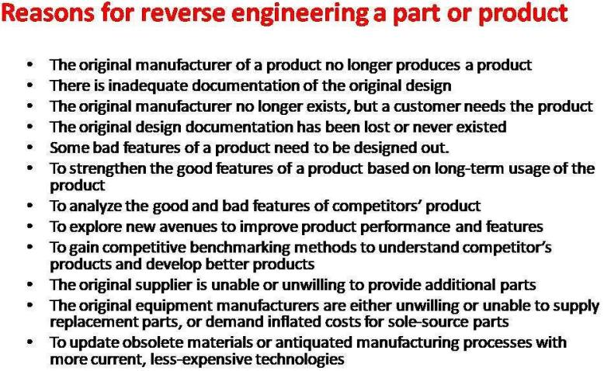

Slide 23
Configuration Management
Software changes are inevitable
One goal of software engineering is to improve how easy it is to change software
Configuration management is all about change control
Every software engineer has to be concerned with how changes made to work products are tracked and propagated throughout a project.
To ensure quality is maintained the change process must be audited.

Slide 24
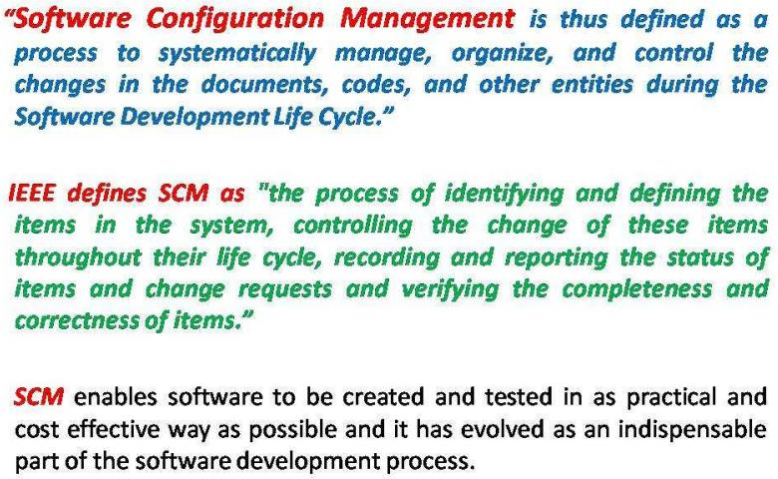

Slide 25
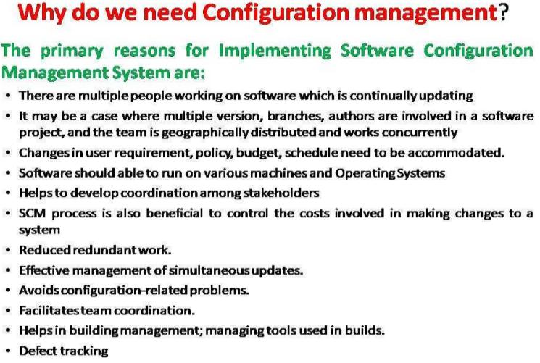

Slide 26
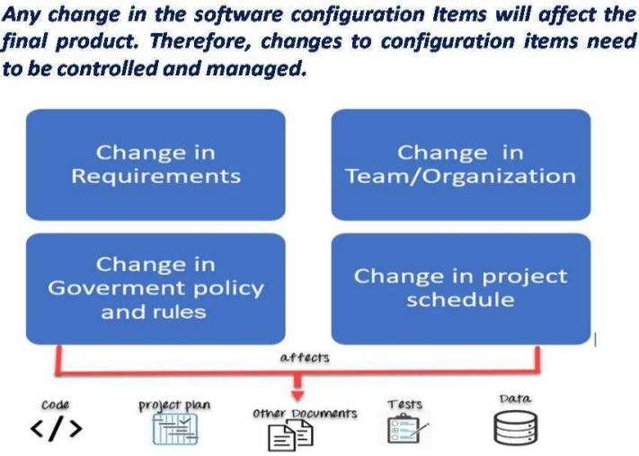

Slide 27
Software Configuration Items
CI is a component of a system that is treated as a self contained unit for the purposed of identification and change control
Computer programs
Source code
Test case
Documentation
technical
user
Data
contained within the program
external data(e.g. files and databases)

Slide 28
Tasks In SCM Process
Configuration identification
Baselines
Version Control
Change Control
Configuration Status Accounting
Configuration Audits and Reviews

Slide 29
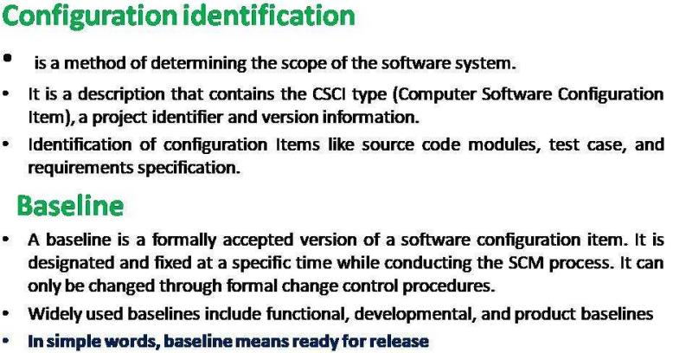

Slide 30
Versioning
Versioning allows development teams to keep track of changes they make to the project code.
The changes may include new functions, features or bug fixes. Minor changes can also be tracked in a similar manner.
Sometimes, entirely new functions and features are released based on developments across multiple versions.

Slide 31
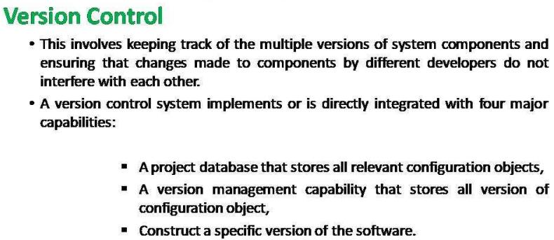

Slide 32
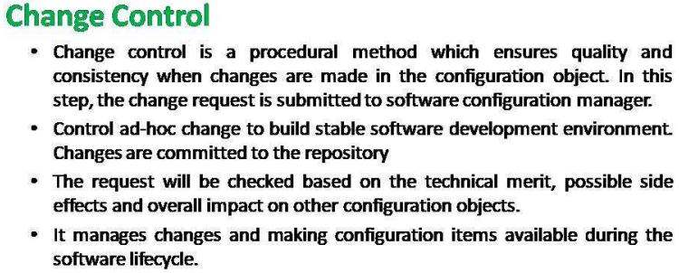

Slide 33
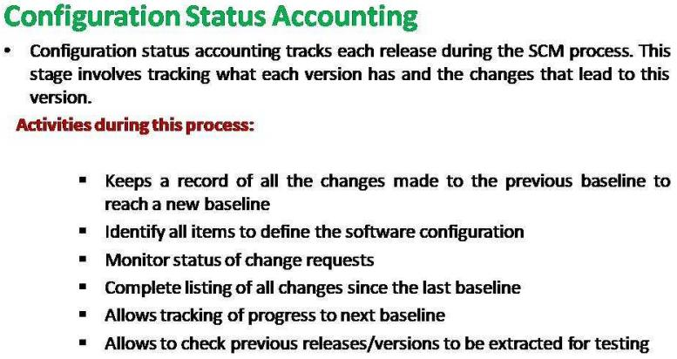

Slide 34
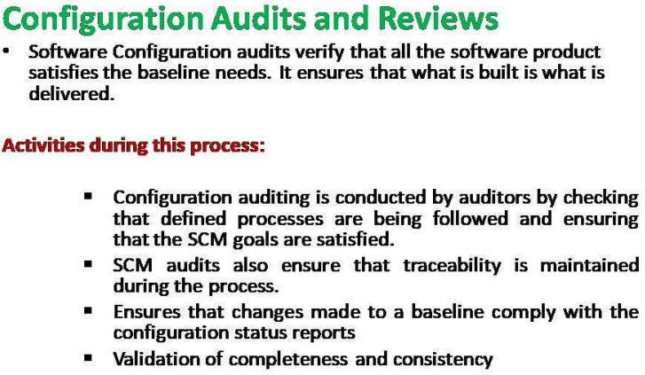

Slide 35
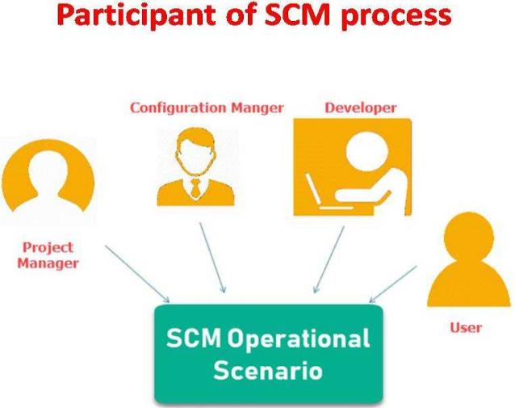

Slide 36
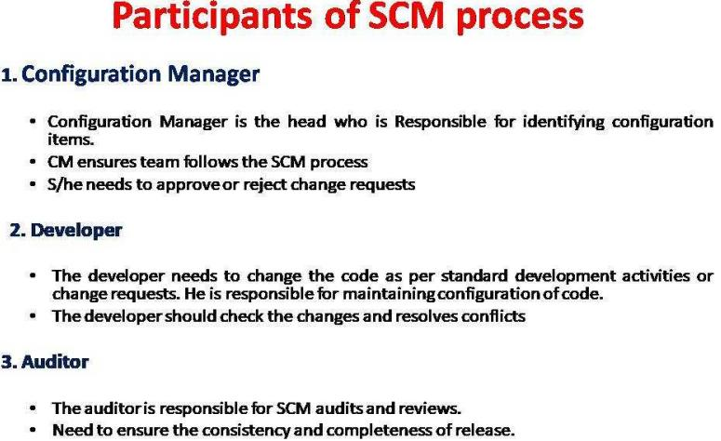

Slide 37
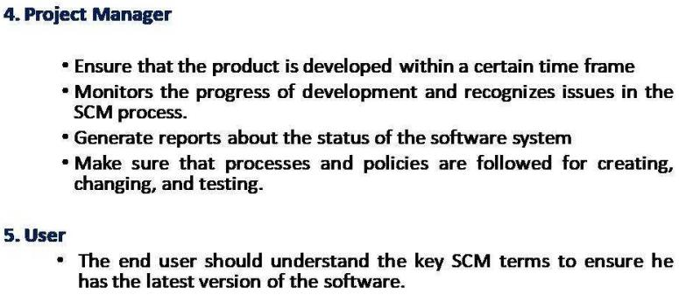

Slide 38
Unit 7(Maintenance) : Assignment
What is software reengineering? List its advantages. Explain source code translation and reverse engineering approach in brief.
Why software maintenance is considered as major component in SDL? Explain software maintenance types.
What do you mean by configuration management? Why it is important? Explain
Explain about reverse engineering.
Explain about the maintenance prediction.

